Slide 1
Dijkstra's Algorithm - Graph Shortest Path
COP 4530 Programming Project 4
Group Presentation
Miguel Mateo Osorio Vela U96987884
Evan Persad U28675784
Phong Lien U31559628

Slide 2
Overview
What we aim to achieve with this project.
What is Dijkstra's Algorithm
Quick Explanation from handwritten Example
Graph ADT design explanation
Code Structure
Live demo
Graph Results/Output
Conclusion

Slide 3


Our Project Algorithm Will Achieve
The shortest path from a source to all other nodes.
The use of priority queue (min-heap) to explore cheapest paths first.
Have each vertex visited once; updates shortest known distances.
Stores path and distance to each vertex during traversal.

Slide 4

Graph ADT Design
Vertices are stored with unique string labels.
Edges store pair of vertex labels and weights.
Undirected graph represented using adjacency lists.
Implements add/remove vertex and edge functionality.

Slide 5
What is Dijkstra’s Algorithm? (Simplified)
A graph search algorithm that finds the shortest path from a starting vertex to all other vertices in a weighted graph.
Works only with non-negative edge weights.
Uses a priority queue to explore vertices with the lowest known distance first.
Continuously updates the shortest path to each vertex based on edge weights.
Guarantees the optimal path from the source to each node.

Slide 6
More Indepth Explanation (Better understanding of functionality)
Initialization:
Assign a tentative distance value to every vertex: 0 for the source, and ∞ (infinity) for all others.
Mark all vertices as unvisited. Create a set of all unvisited vertices.
Main Loop:
Select the unvisited vertex with the smallest tentative distance — this becomes the "current vertex".
For the current vertex, consider all of its unvisited neighbors.
Calculate their tentative distances via the current vertex, and if this new path is shorter than the current stored distance, update it.
After considering all neighbors, mark the current vertex as visited. A visited vertex will not be checked again.
Repeat:
Continue the loop until all vertices are visited or the smallest tentative distance among unvisited vertices is infinity (which happens when vertices are unreachable).

Slide 7
Quick and Easy to Understand Example Algorithm
In the next few slides we will go over a simplified and very easy to understand example of Dijkstra's Algorithm
I
I
I
V

Slide 8
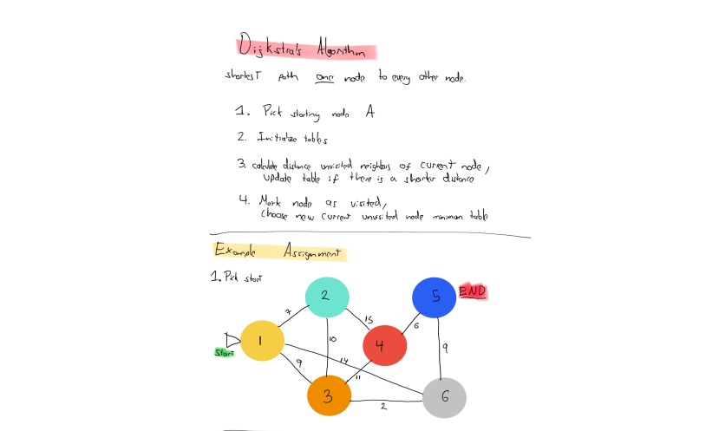

Slide 9
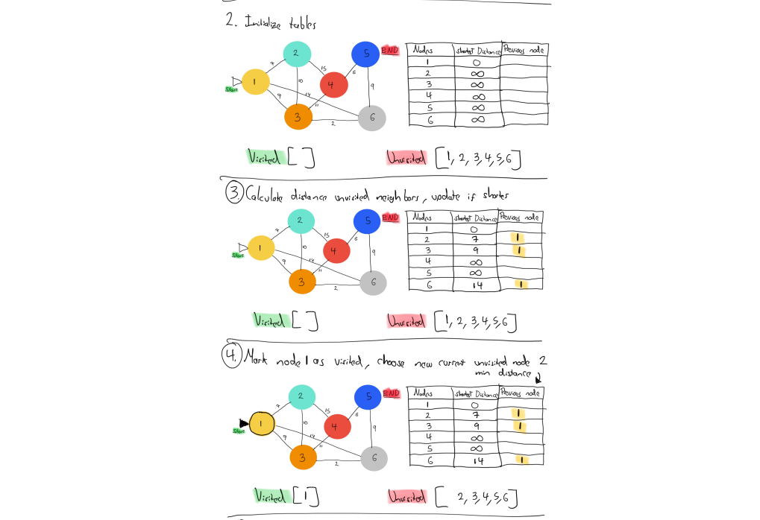

Slide 10
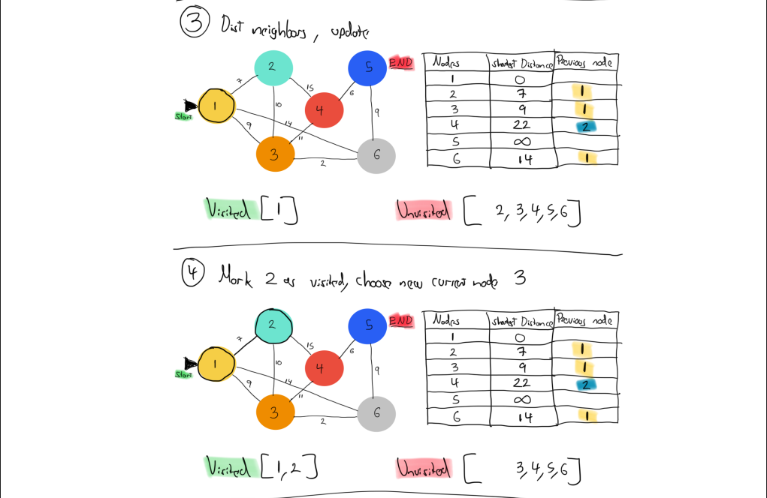

Slide 11
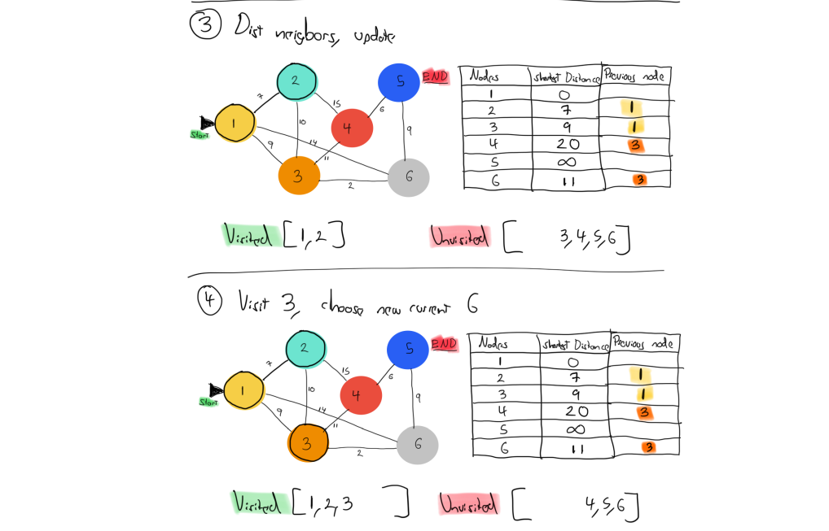

Slide 12
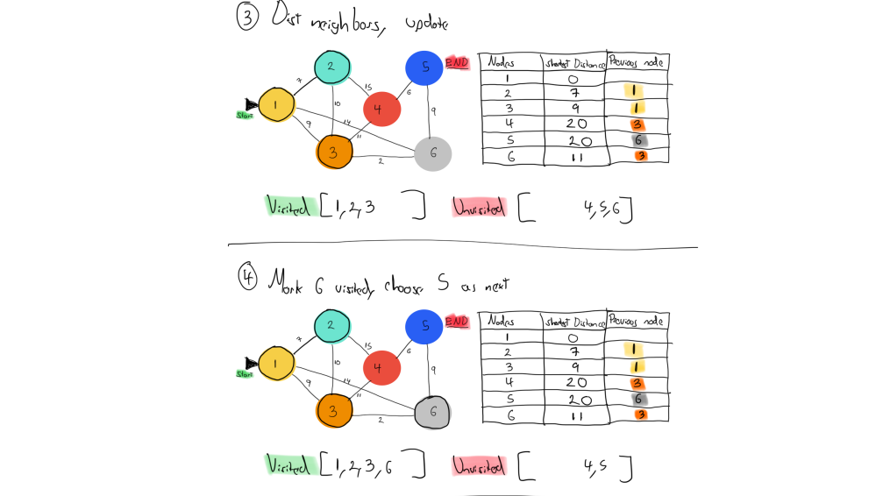

Slide 13
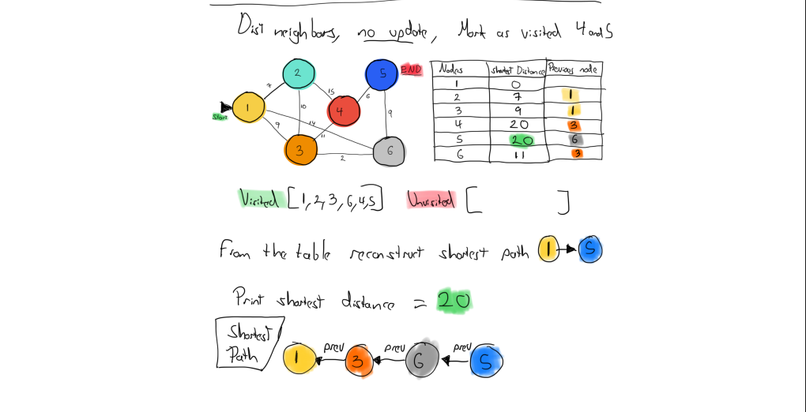

Slide 14
Code Implementation Structure
A very simple summary of the structure and methods used in our code.
Graph class encapsulates all functionality.
main.cpp sets up two test graphs.
Calls shortestPath and prints distance and path.
print_path function used for formatted output.

Slide 15

Live Demo
Now we will do a quick Live demo of our code to show its functionality and output!

Slide 16
Graph 1: Results
Vertices: 1 through 6
Edges with weights like (1-2: 7), (3-6: 2), etc.
Shortest path from 1 to 5: 1 -> 3 -> 6 -> 5
Total Distance: 20

Slide 17
Graph 2: Results
Campus buildings: BSN, LIB, ENB, etc.
Path from ENB to SUN: Distance = 2885
Path from LIB to CAS: Distance = 1532
Graph used real-world weighted examples

Slide 18
Conclusion
We have successfully:
Implemented a Graph ADT and Dijkstra’s Algorithm to compute shortest paths.
Verified the algorithm with multiple test cases on two different graphs.
Gained deeper understanding of real-world application of a theoretical concept learned in class.

Slide 19
Thank you for your time and attention!

